Slide 1

Image Captioning for Remote Sensing
Using CNN & Transformer Architectures for Remote Sensing Intelligence
Saptajit Banerjee – ID25S001
‹#›

Slide 2
Introduction
Context : The rapid expansion of high-resolution remote sensing imagery requires automated captioning systems to accelerate intelligence gathering and disaster management.
Domain Challenge : Satellite images are significantly harder to process than normal photos due to their top-down angles, tiny crowded objects, and complex spatial layouts.
Technical Bottleneck : Traditional sequence-to-sequence models (CNN-LSTM, CNN-GRU) process data sequentially, creating an information bottleneck that fails to capture the full context of an image.
The Proposed Architecture : A hybrid approach where a CNN extracts spatial features from the image, which are then fed into a Transformer. The Transformer uses Attention mechanisms to bypass sequential bottlenecks and directly map those visual features to accurate text.

Slide 3
Objectives
Baseline Evaluation (Phase 1) : Rigorously benchmark traditional recurrent models against a baseline Transformer on the Flickr8K dataset to establish architectural superiority.
Advance Multi-Modal Learning : Bridge the semantic gap between computer vision and NLP by designing a custom Transformer capable of mapping complex remote sensing imagery to fluent text.
Architectural Optimization : Enhance the multi-modal pipeline by integrating an EfficientNetB7 backbone, SiLU activations, increased encoder-decoder depth, multiple attention heads and Manual Label Smoothing.
Real-World Validation (Zero-Shot) : Evaluate the final model’s robustness through out-of-distribution (OOD) testing on unannotated, real-world satellite imagery from the 2026 Iran War.

Slide 4
Data Sources
Flickr8K — Generic Dataset (GitHub)
Role: Generic baseline — trains all 3 candidate model architectures before domain-specific evaluation
Content: 8,000 natural photographs with 5 human-written captions each
Model Trained:
CNN-LSTM
CNN-GRU ·
Single-Layer Transformer
Purpose: Establish baseline performance & select the best architecture for satellite fine-tuning
Source: github.com/awsaf49/flickr-dataset
Satellite Image Caption Generation (Kaggle)
Role: Domain-specific fine-tuning using the best model selected from Flickr8K evaluation
Content: Remote sensing tiles — airports, forests, residential, industrial, agricultural zones
Model Trained:
Single-Layer Transformer (best performer on Flickr8K)
Multi-Layer Transformer
Goal: Produce RS-specific semantic descriptions with domain vocabulary
Source: kaggle.com/datasets/tomtillo/satellite-image-caption-generation
‹#›

Slide 5
Phase 1 Results: Baseline Comparison (Flickr8K)
MODEL | VALIDATION ACCURACY | VALIDATION LOSS | GREEDY BLEU-1 | GREEDY BLEU-2 | BEAM (k=2) BLEU-1 | BEAM (k=2) BLEU-2
CNN-LSTM | 38.84 % | 3.2028 | 55.70 % | 38.93 % | 60.21 % | 42.64 %
CNN-GRU | 40.53 % | 3.1306 | 55.40 % | 37.29 % | 59.88 % | 41.72 %
SINGLE LAYER TRANSFORMER | 41.39 % | 11.2521 | 58.97 % | 41.35 % | 60.58 % | 43.12 %
Transformer Superiority:
Outperformed CNN-LSTM and CNN-GRU baselines because Self-Attention and Cross-Attention directly capture long-term image-text dependencies, completely eliminating the sequential information bottlenecks inherent to recurrent models.

Slide 6
Proposed Multi-Layer Transformer Architecture
Output
Vision Extractor Upgrade : Upgraded the CNN backbone to EfficientNetB7 to better capture complex spatial hierarchies. Output features are projected to a 512-embedding dimension using a Dense layer with a SiLU (Swish) activation.
Deeper Transformer Stack : Increased architectural depth by stacking 3 Encoder and 3 Decoder blocks, utilizing 8 Attention Heads per block to process complex image-text dependencies.
Optimized Non-Linearity : Replaced standard ReLU activations with SiLU across all Feed-Forward Network (FFN) sublayers to significantly improve gradient flow.
Hardware Adaptation & Regularization : Due to the massive parameter increase, batch size was reduced from 64 to 8 to resolve Kaggle Out-Of-Memory (OOM) errors. Furthermore, L2 Regularization—which empirically hurt performance—was replaced with a Dropout rate of 0.5 to prevent overfitting.
Fully Connected Layers
Encoder
Self Attention
Encoder
Cross Attention
Decoder
Encoder
Decoder
Self Attention
EfficientNet
(CNN)
Decoder
Images
Captions

Slide 7
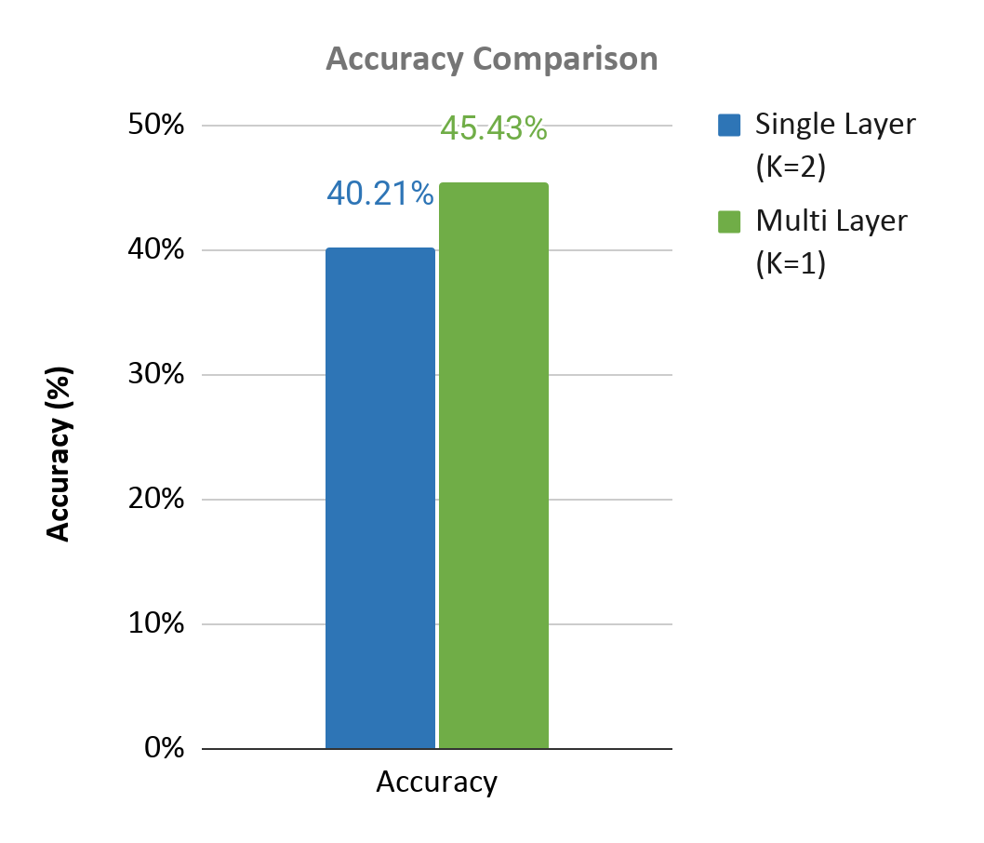
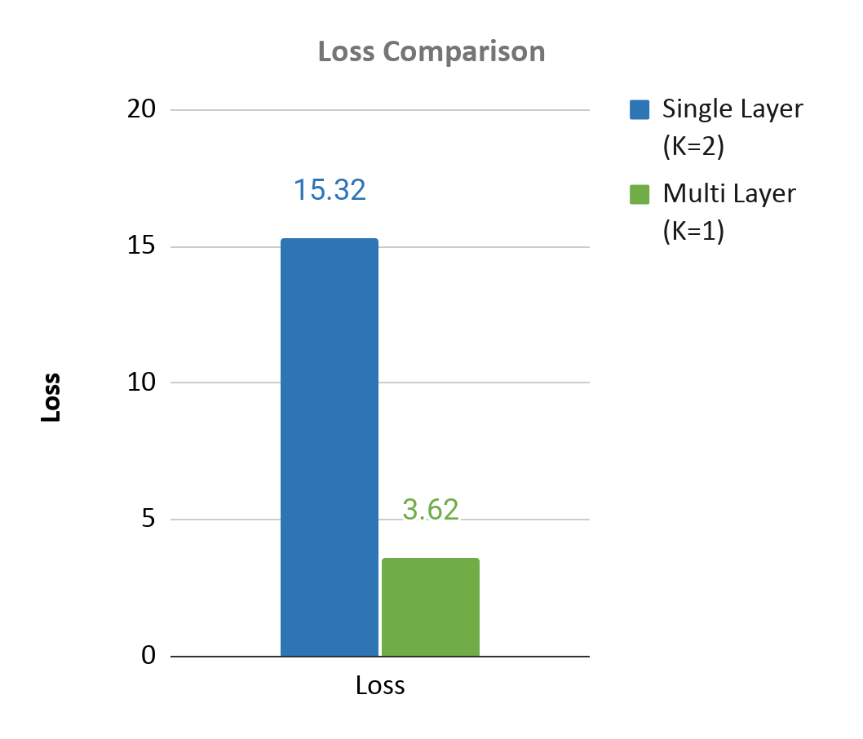
Single Layer vs Multi Layer Transformer
Significant Gains in Accuracy & Loss: The Multi-Layer model improved accuracy by 13.0% (to 45.43%) and drastically reduced cross-entropy loss by 76.3% (from 15.31 to 3.62).
Universal BLEU Dominance: The proposed Multi-Layer architecture outperformed the Single Layer baseline across all evaluation metrics and beam widths, notably achieving a peak BLEU-4 score of 23.83%.
Multi-Word Phrase Coherence: The Multi-Layer model showed a gradual, stable score decline from BLEU-1 to BLEU-4, proving it generates coherent multi-word phrases. In contrast, the Single Layer Model’s steep decline shows it struggles to maintain context beyond individual tokens.

Slide 8
Single Layer vs Multi Layer Transformer
MODEL | BEAM WIDTH | BLEU-1 | BLEU-2 | BLEU-3 | BLEU-4
Single Layer | 1 | 48.85 % | 28.06 % | 17.85 % | 11.37 %
Single Layer | 2 | 47.26 % | 27.86 % | 18.01 % | 11.46 %
Single Layer | 3 | 45.33 % | 26.38 % | 16.66 % | 10.21 %
Single Layer | 4 | 44.97 % | 26.35 % | 16.53 % | 9.94 %
Multiple Layer | 1 | 58.24 % | 41.07 % | 30.96 % | 23.83 %
Multiple Layer | 2 | 57.29 % | 40.50 % | 30.39 % | 23.23 %
Multiple Layer | 3 | 55.63 % | 39.36 % | 29.68 % | 22.93 %
Multiple Layer | 4 | 53.86 % | 38.05 % | 28.82 % | 22.39 %

Slide 9
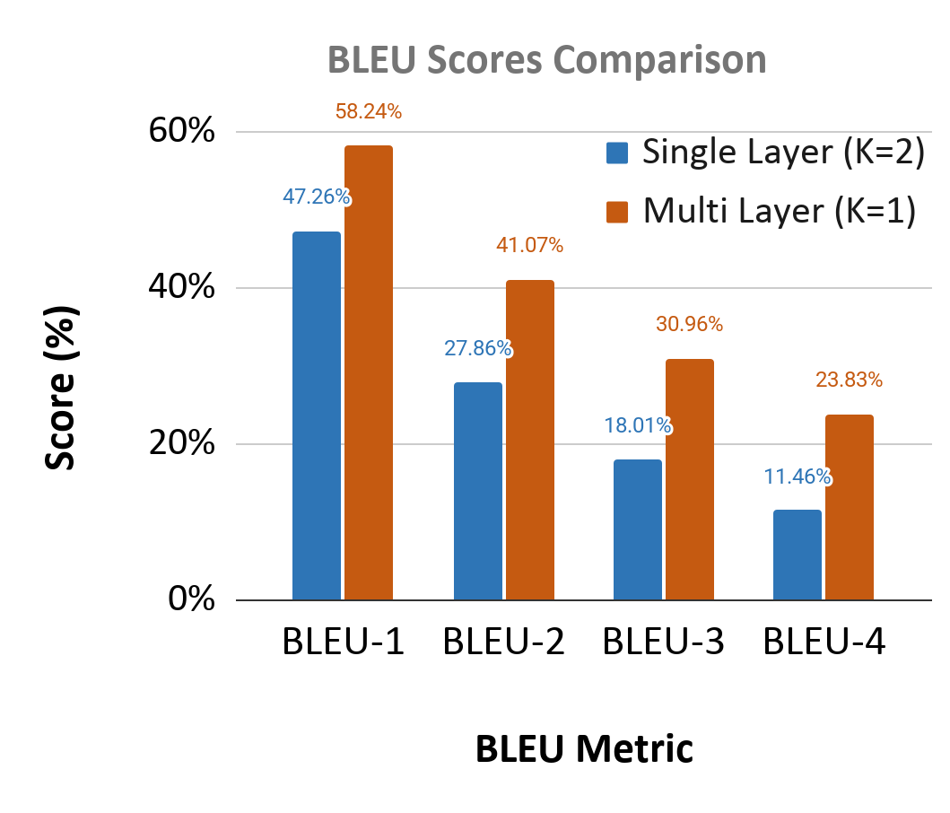
Single Layer vs Multi Layer Transformer
Consistent Improvement : The Multi Layer Transformer outperformed the Single Layer Transformer across all BLEU metrics and all beam widths without exception.
BLEU Scores Improve with Phrase Length : Improvement grows progressively from BLEU-1 to BLEU-4, indicating more coherent and fluent multi-word caption generation.
Competitive with Published Baselines : The Multi Layer Transformer's BLEU scores are competitive with published baselines on remote sensing image captioning tasks.
Collective Effect of Modifications : The gains result from the combined effect of the multi-layer stack, multiple attention heads, EfficientNetB7, SiLU activations, Label Smoothing, and length-normalised Beam Search.

Slide 10
Best Performance Comparison
Exceptional BLEU-4 Gains : The Multi-Layer model achieved a 107.9% relative improvement at BLEU-4, more than doubling the baseline score.
Significance of the BLEU-4 Metric : As the strictest metric requiring exact 4-word sequence matches, this massive leap proves the model is not just guessing isolated words, but possesses genuine contextual comprehension and syntactic fluency.
Competitive Baseline Performance : The peak BLEU-4 score of 23.83% is highly competitive with published research on satellite image captioning tasks.
Metric | Single Layer (K=2) | Multi Layer (K=1) | Improvement
Accuracy | 40.21 % | 45.43 % | +13%
Loss | 15.3162 | 3.6234 | - 76.3%
BLEU-1 | 47.26 % | 58.24 % | +23.2%
BLEU-2 | 27.86 % | 41.07 % | +47.4%
BLEU-3 | 18.01 % | 30.96 % | +71.09%
BLEU-4 | 11.46 % | 23.83 % | +107.9%

Slide 11
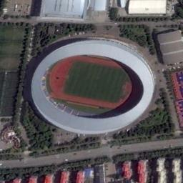
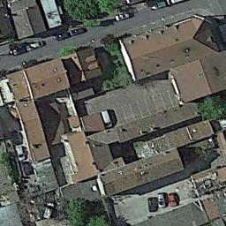
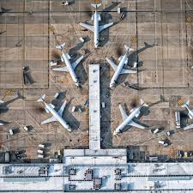
Qualitative Comparison
Single Layer Caption | many green trees and several buildings are around a playground
Multi Layer Caption | many buildings and some green trees are around a stadium
Single Layer Caption | some green buildings and trees are close to a road
Multi Layer Caption | some buildings and green trees are in a medium residential area
Single Layer Caption | several cars are parked in a parking lot
Multi Layer Caption | three planes are parked on an airport
Tokyo Olympics Stadium
Residential Area
Dulles International Airport

Slide 12
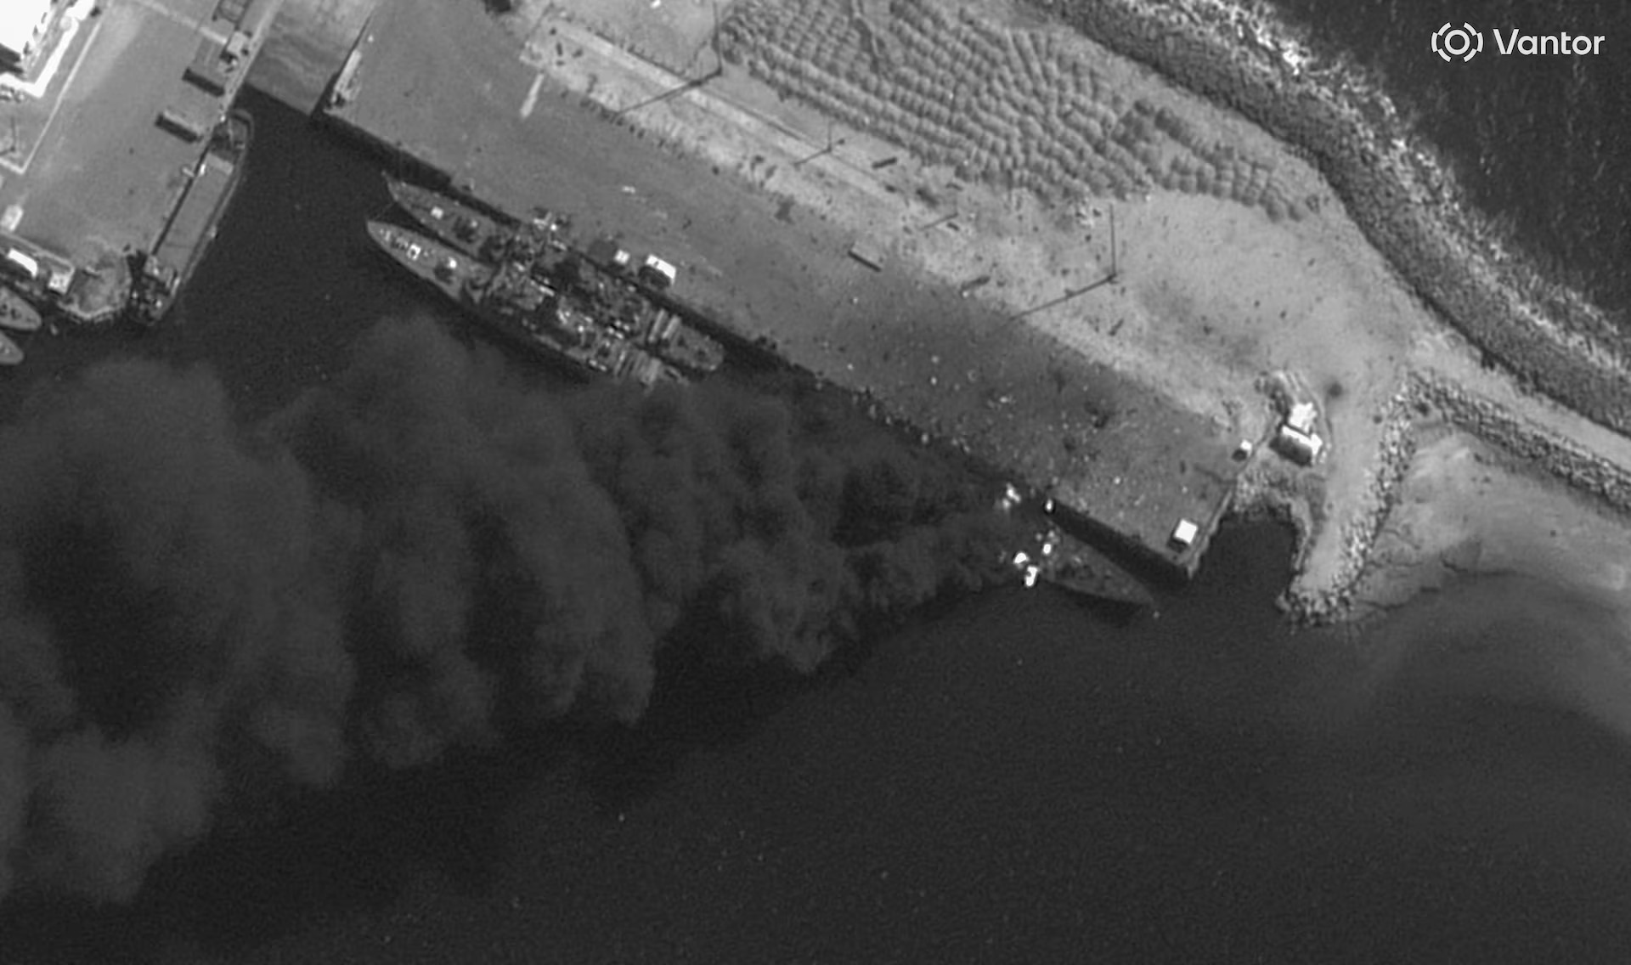
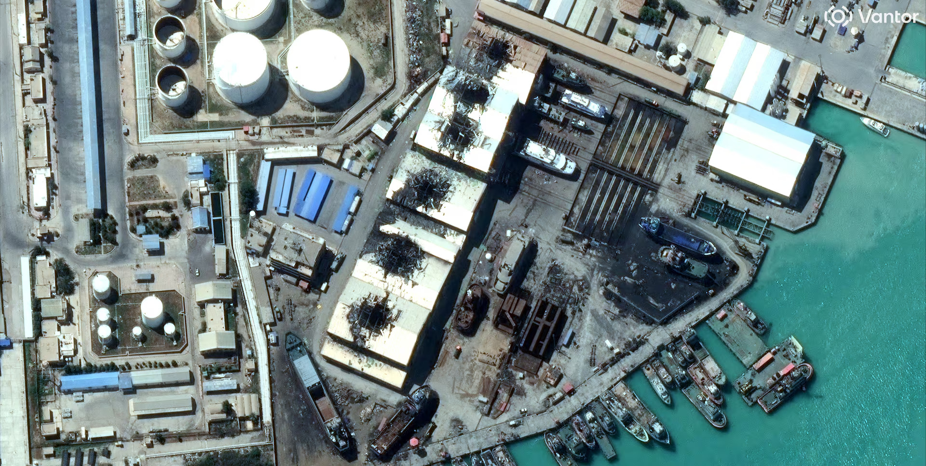
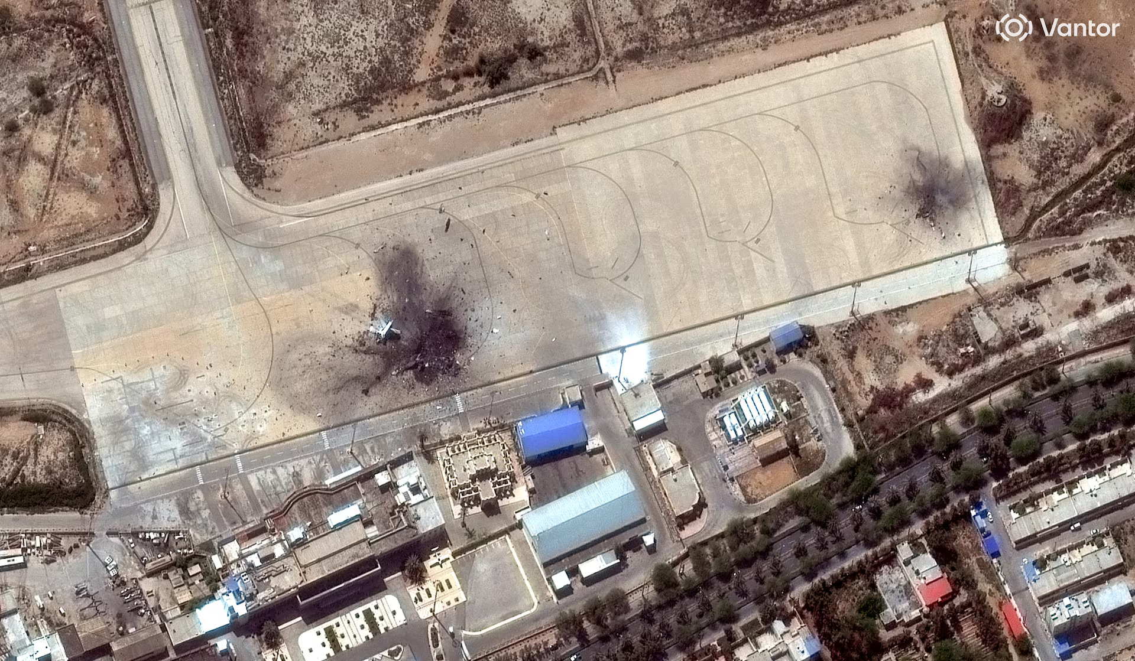
Captioning The 2026 IRAN WAR Conflict Zones
Caption | several boats are in a port near a dock
A frigate on fire at the Konarak naval base in Iran
Caption | many storage tanks are close to several buildings
Caption | many planes are parked in an airport near a road
A frigate on fire at the Konarak naval base in Iran
Damage at naval facilities in Bushehr, Iran
A destroyed aircraft at Bushehr airbase, Iran

